Slide 1
Blockchains vs. Distributed Databases: Dichotomy and Fusion
Submitted By
Group 2
21366035 - Md. Sabbir Ahmed
22366029 - Khondoker Nazia Iqbal

Slide 2
Abstract
Provided a principled framework for analyzing the emerging trend of blockchain-database fusion.
Proposed a taxonomy to illustrates the dichotomy across four dimensions: Replication, Concurrency, Storage, and Sharding.
Design choices goal: Security for blockchains, and Performance for distributed databases.
Conducted performances analysis on:
Blockchains: Quorum and Hyperledger Fabric
Distributed Databases: TiDB, and etcd.

Slide 3
Introduction
Existing works that compare blockchains and databases focused only on throughput and security.
To overcome these limitations, the paper provided a comprehensive dichotomy of blockchains and databases.
Performed a twin study of blockchains and distributed database systems as two types of transactional systems.
Proposed a framework that explains the performance differences and estimates the performance of future hybrid systems.

Slide 4
Background
Blockchain
A system in which a record of transactions made in bitcoin or another cryptocurrency are maintained across several computers that are linked in a peer-to-peer network.
Divided into two categories:
Permissionless
Permissioned

Slide 5
Background
Distributed Databases
A database that consists of two or more files located in different sites either on the same network or on entirely different networks.
Two distinctive movements under this distributed direction:
NoSQL system
NewSQL system

Slide 6
Taxonomy
Replication is the technique of storing copies of the data on multiple nodes called replicas.
The key challenge is to ensure consistency under failures
Replication Model:
Blockchains replicate an ordered log of transactions (or ledger).
Distributed databases replicate the ordered log of read and write operations on top of the storage.
Replication Approach:
Primary-backup
State-machine replication
Failure Model
Replication

Slide 7
Taxonomy
Concurrency refers to the extent to which transactions are executed at the same time.
Transactions are executed either:
Serially (Sequentially)
Concurrently
Blockchain supports serial execution
Distributed database supports concurrent execution
Recent blockchains are adopting some simple concurrency techniques often found in databases
Concurrency

Slide 8
Taxonomy
Storage Model:
In Blockchain
Append-only ledger abstraction
In Distributed Databases:
Direct access without historical query
Index:
Indexes play an instrumental role on the state storage to facilitate data access.
In Blockchain:
Authenticated data structure: Merkle Tree, etc.
In Distributed Databases:
Hardware-conscious index: PSL, FAST, etc
Storage

Slide 9
Taxonomy
Sharding is a common technique in distributed databases for achieving scalability.
Shard Formation:
Blockchains: Node-aware shard formation
Distributed Databases: Workload-aware shard formation
Atomicity:
Blockchains: 2PC and BFT-based replication
Distributed Databases: 2PC with centralized coordinator
Sharding

Slide 10
Fusion of Blockchains and Databases
Out-of-the-blockchain Databases:
A hybrid approach that starts with a blockchain (or a blockchain-like system) and build database features on top of it
Examples of this approach include BlockchainDB, Veritas, and FalconDB
They are more security-driven
Out-of-the-database Blockchains:
Another hybrid design approach is to start with a database, then add blockchain features to it.
Examples of this approach include BigchainDB , Blockchain Relational Database (BRD), and ChainifyDB
Main goal is performance.

Slide 11
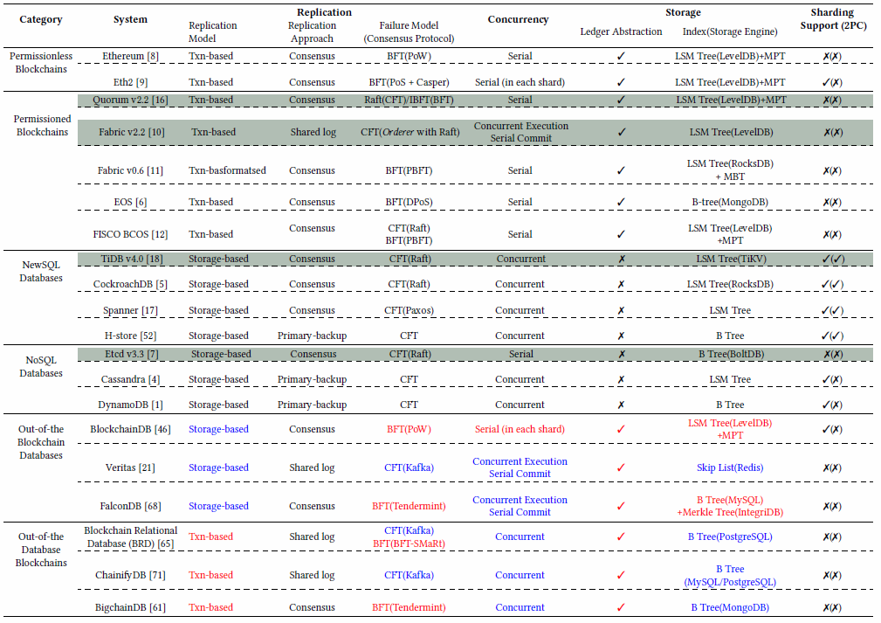

Slide 12
Experimental Setup
Two permissioned blockchains selected by the authors:
Quorum: It represents order-execute blockchains
Hyperledger Fabric
It represents execute order-validate blockchains
Two distributed databases selected by the authors:
TiDB
It represent NewSQL distributed database
etcd
It represent NoSQL distributed database
Systems

Slide 13
Experimental Setup
All systems were ran in full replication mode
For Fabric transaction was executed and endorsed by all peers
For TiDB, the replication factor was same as the number of nodes
Quorum and Fabric were configured to use Raft
Experiments were conducted on an in-house cluster consisting of 96 nodes
Each node was equipped with Intel Xeon E5-1650 CPU, 32GB RAM, and 2TB hard disk
Setup

Slide 14
Result and Analysis
After summarizing the main findings, the detailed experimental analysis was provided with the below mentioned parameters:
Peak performance
Replication
Concurrency
Storage
Sharding

Slide 15
Result and Analysis (continued)
Peak Performance
YCSB:
Analyzed the peak performance of the four systems under the default configurations
Populated each system with 100K records, each of size 1 KB
Measured the throughput and latency against two YCSB workloads
Also measured the performance of TiKV, the replicated storage of TiDB
Figure 1 shows the peak throughput of the five systems

Slide 16
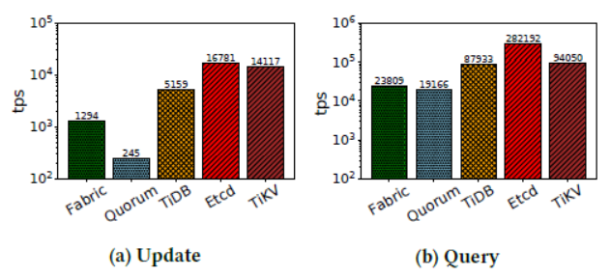
Figure-1: Throughput of YCSB workload (log scale)

Slide 17
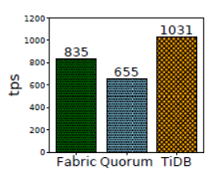
Result and Analysis (continued)
Peak Performance
Smallbank:
Figure 2 compares the OLTP performance under the Smallbank workload
The request key follows a Zipfian distribution with coefficient θ = 1 on 1M records
Did not include etcd because it does not support general transactional workloads
Figure-2: Throughput of the skewed Smallbank workload (1M records)

Slide 18
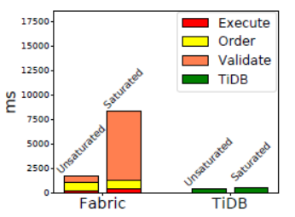
Result and Analysis (continued)
Replication
Effect of replication model:
Figure 3 compares the latency of a transaction when the systems are both unsaturated and saturated
Fabric exhibits a significant increase in latency when the system is saturated
When Fabric is unsaturated, the order and validate phases take roughly 700ms each, while the execute phase takes below 500ms
Figure-3: Latency breakdown

Slide 19
Result and Analysis (continued)
Replication
Effect of failure model:
Compared the performance of Raft and Istanbul Byzantine Fault Tolerant (IBFT)
Recall that Raft tolerates only crash failures
IBFT shares the crux of PBFT, which consists of a three phase commit

Slide 20
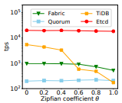
Result and Analysis (continued)
Concurrency
Effect of skewness:
Used skewed workloads in which each transaction modifies a single record
The records’ keys follow a Zipfian distribution that varies based on the skewness coefficient θ
Figure 4 shows the throughputs and the corresponding abort rates
Figure-4: Throughput (log scale)

Slide 21
Result and Analysis (continued)
Concurrency
Effect of operation count:
Update operations per transaction to analyze the impact of transaction atomicity on performance
Vary the record size to remove the effect of transaction size
For example, if a transaction writes 10 records, then each record contains 100 bytes

Slide 22
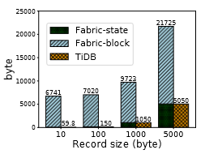
Result and Analysis (continued)
Storage
Effect of record size on storage:
Figure 5 shows the storage cost per record
Fabric incurs a much higher storage overhead than TiDB
No additional storage used by TiDB because no historical information is maintained
Figure-5: Storage breakdown
in Fabric and TiDB

Slide 23
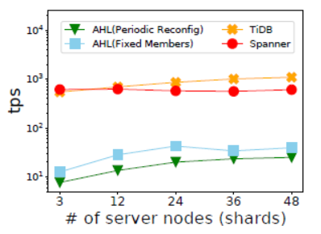
Result and Analysis (continued)
Sharding
Authors disable full replication in TiDB, and compare its performance with Spanner, a cloud-based NewSQL database, and Attested Hyperledger (AHL)
AHL leverages trusted hardware to reduce shard size and to improve throughput per shard
Number of nodes in a shard was set to 3 for all the systems, and they pre-populate the state with 1M 1KB-size records
Figure-6: Throughput of the skewed workload (log scale)

Slide 24
Result and Analysis (continued)
Performance of Hybrid Systems
The authors propose a framework for comparing the performance of existing hybrid systems
The framework only supports high-level, back-of-the-envelope comparison according to the authors
The framework explains the performance differences among systems according to their reported results

Slide 25
Related Work
Existing works that compare blockchains and databases have highlighted their high-level differences.
There are some works that conduct separate surveys and benchmarking of distributed databases and blockchains
The work of this paper is more comprehensive as the authors considered systems that are related to blockchains in their designs

Slide 26
Conclusions
The paper presented a comprehensive dichotomy between blockchains and distributed databases
It proposed a taxonomy consisting of four design dimensions: replication, concurrency, storage, and sharding
Using this taxonomy, they discussed how both system types make different design choices
Finally, this work provides the first framework to explore future database-blockchain design fusions

Slide 27
Thank You

